Slide 1
PC 16 | Introduction to DBMS & SQL Part - 1
Manikandan.C

Slide 2
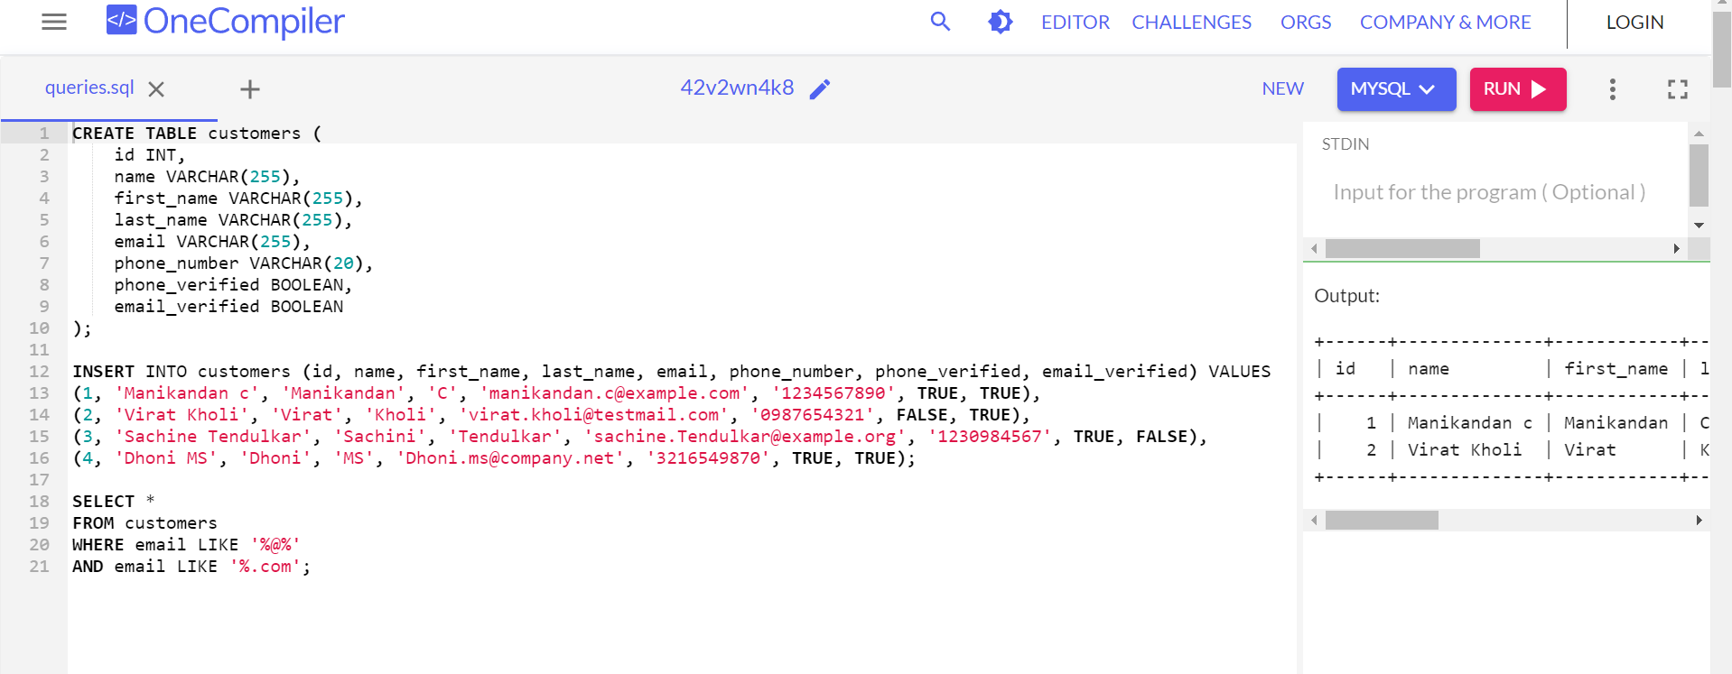
Select Customers

Slide 3
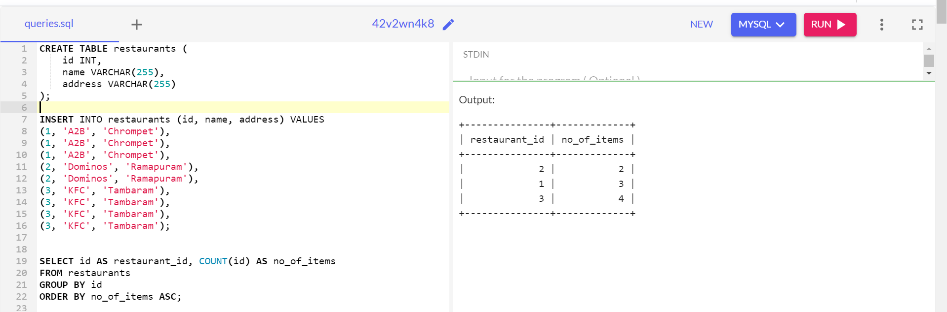
Unique Restaurant IDs

Slide 4
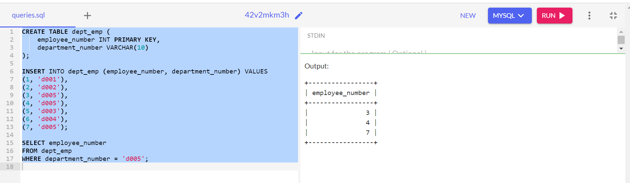
Fetch employee numbers

Slide 5
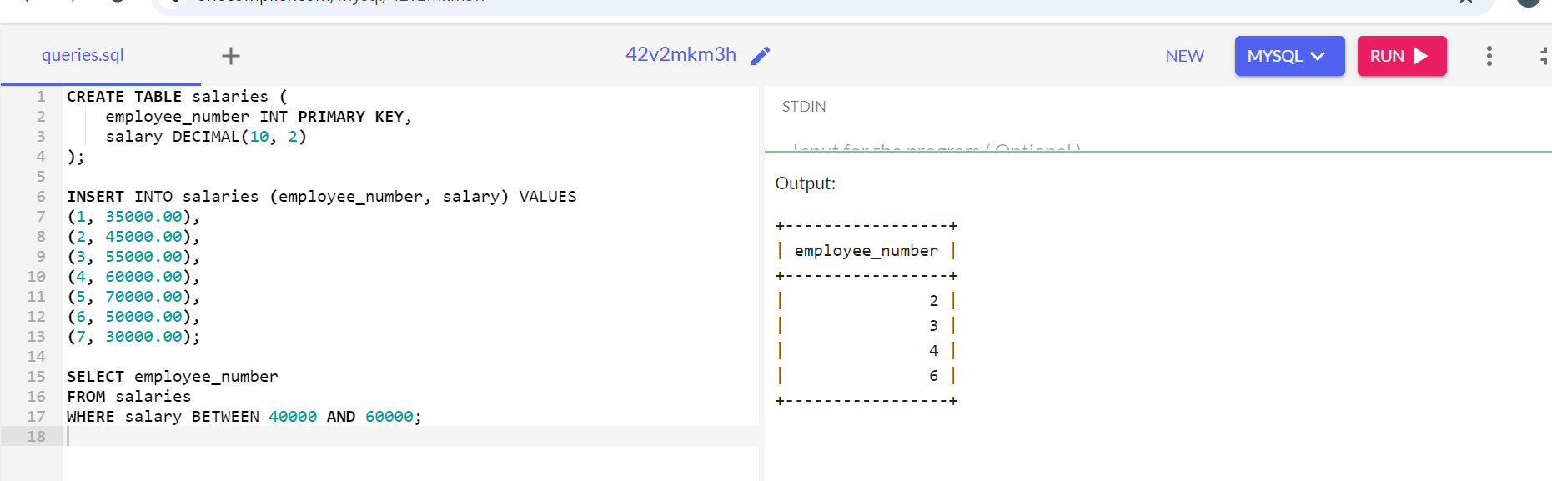
Fetch employees between

Slide 6
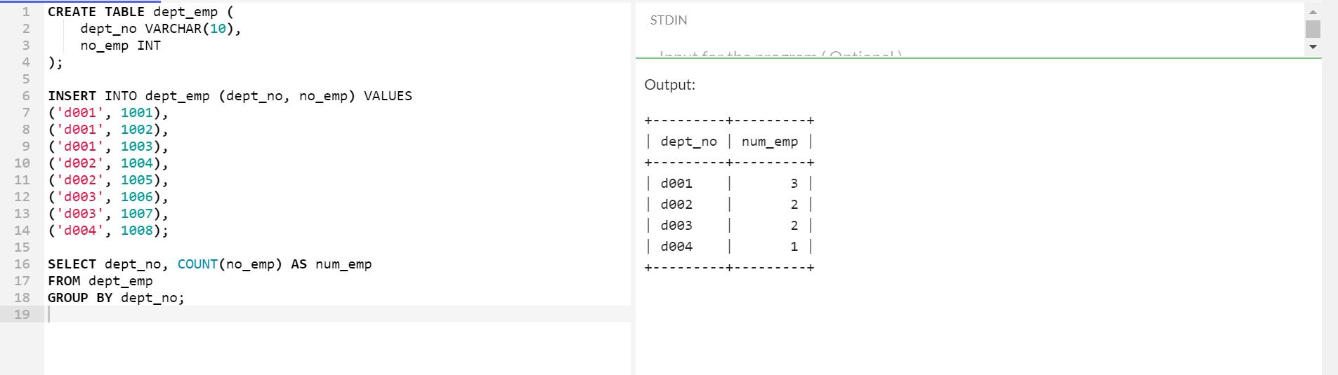
Number of Employess in Each Department

Slide 7
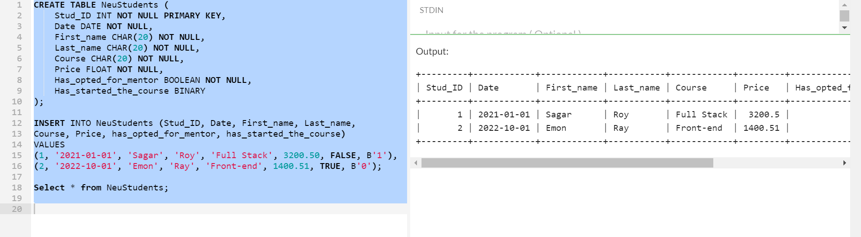
Display First 2 Records

